Slide 1




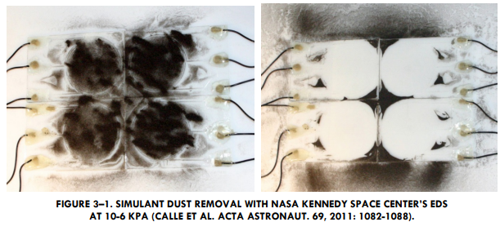
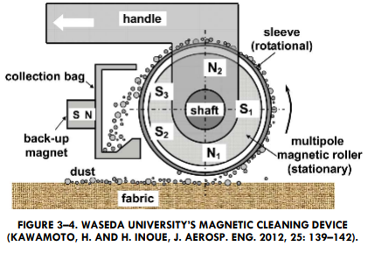
INTRODUCTION
Problem and Existing Solutions
AIAA Caltech Student Branch – 18/11/20
Preliminary Design Review – H.O.M.E.S.
Problems Caused By Spacesuit Dust Ingress Into Habitable Volumes
Increased loads on in-cabin dust mitigation technologies
Incorrect readings during in-cabin experiments
Performance reduction and possible failure of in-cabin equipment
Astronaut health risks
Dust brought to Gateway and Orion when lander returns to lunar orbit
Existing Solutions

